Slide 1
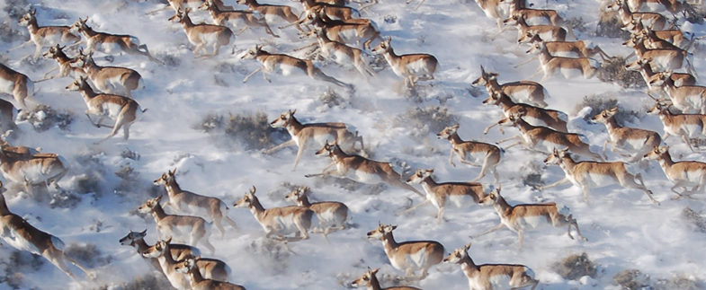
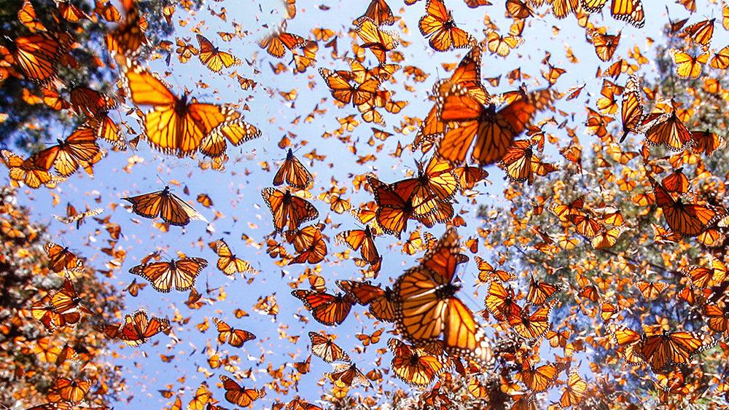
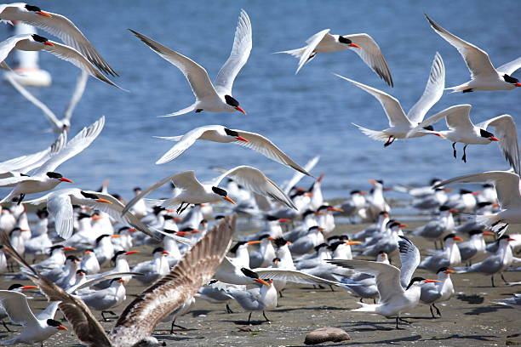
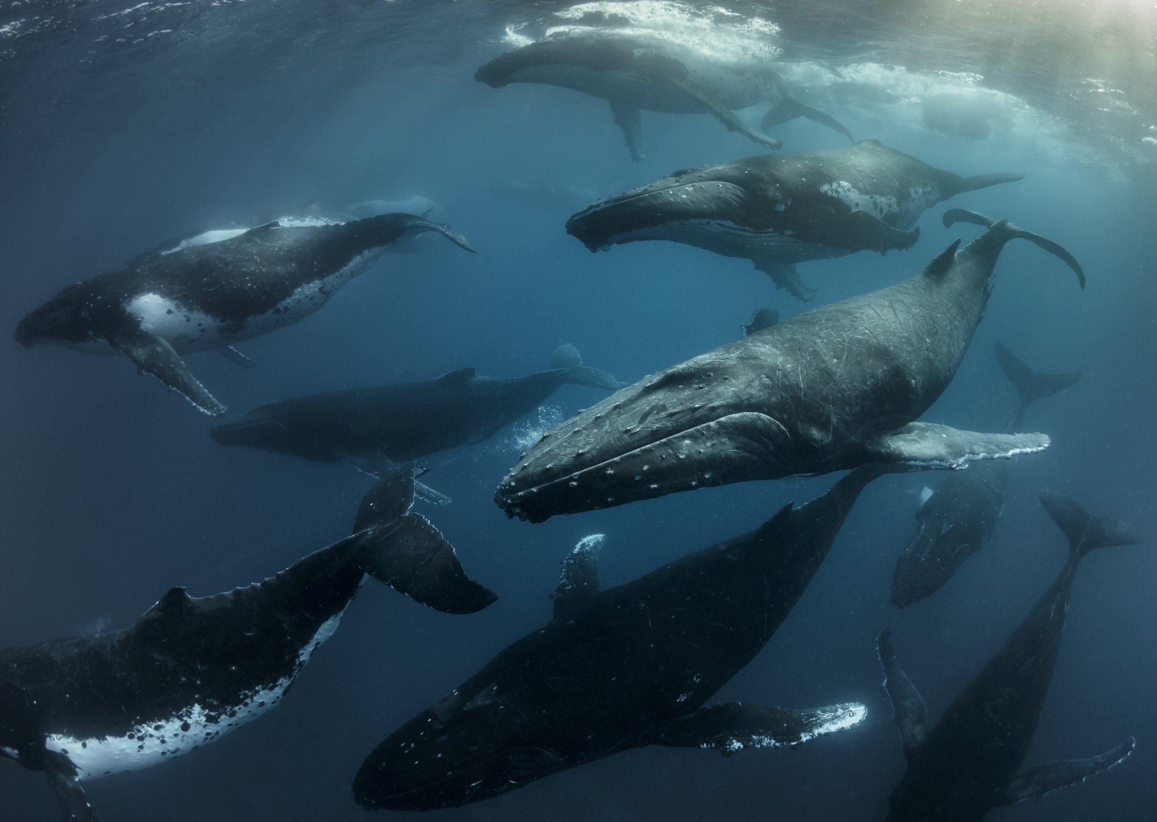



Animal Movement Analyses for Ecologists
@ Sun Yat Sen University | 2026
Notes:
ADD UMASS LOGO

Slide 2
Welcome!
Sponsors, Instructors, and Participants Introductions
Course overviews and schedules
Questions/Comments
Notes:
Goal:
understand why and what we are doing, and the technical part is secondary
homework
leave the class with clear direction, and already have the building blocks in hand

Slide 3
Please introduce yourself
Name
Affiliation
What are you looking for from this course

Slide 4
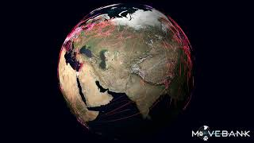
Notes:
a technology driven field
added spatial temporal details from traditional nature observations
fundamental to life on earth
It dictates how individuals acquire resources, evade predators, exchange genetic material, and respond to stressful environments.

Slide 5
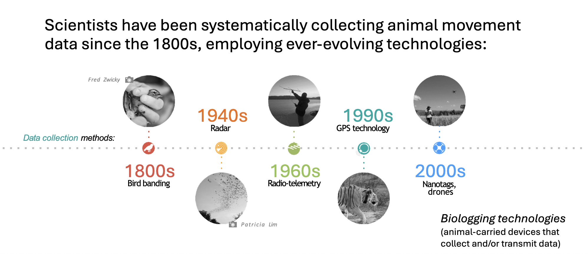
Animal Tracking
A brief history

Slide 6
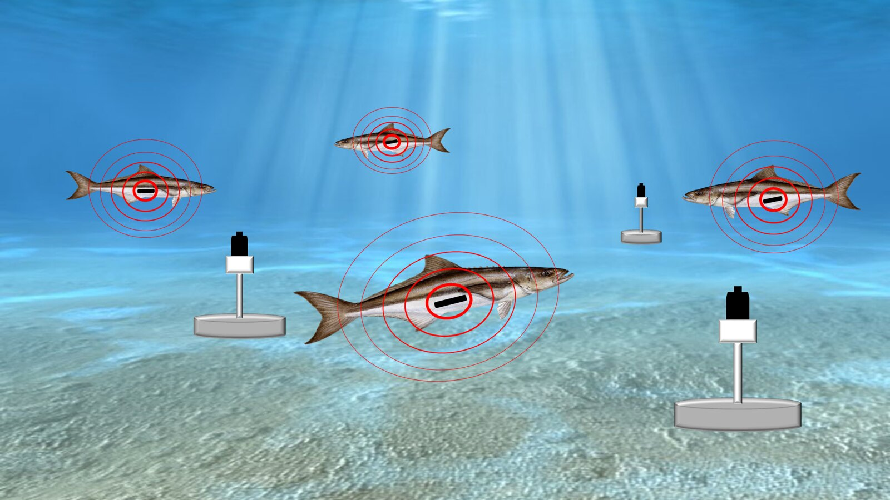
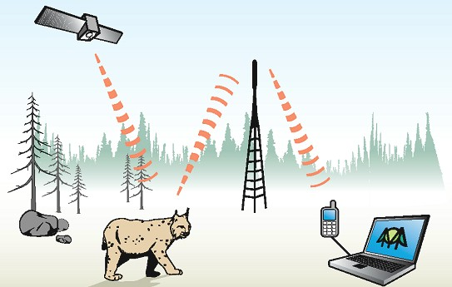
Animal Tracking
Two types of systems
Eulerian Lagrangian

Slide 7
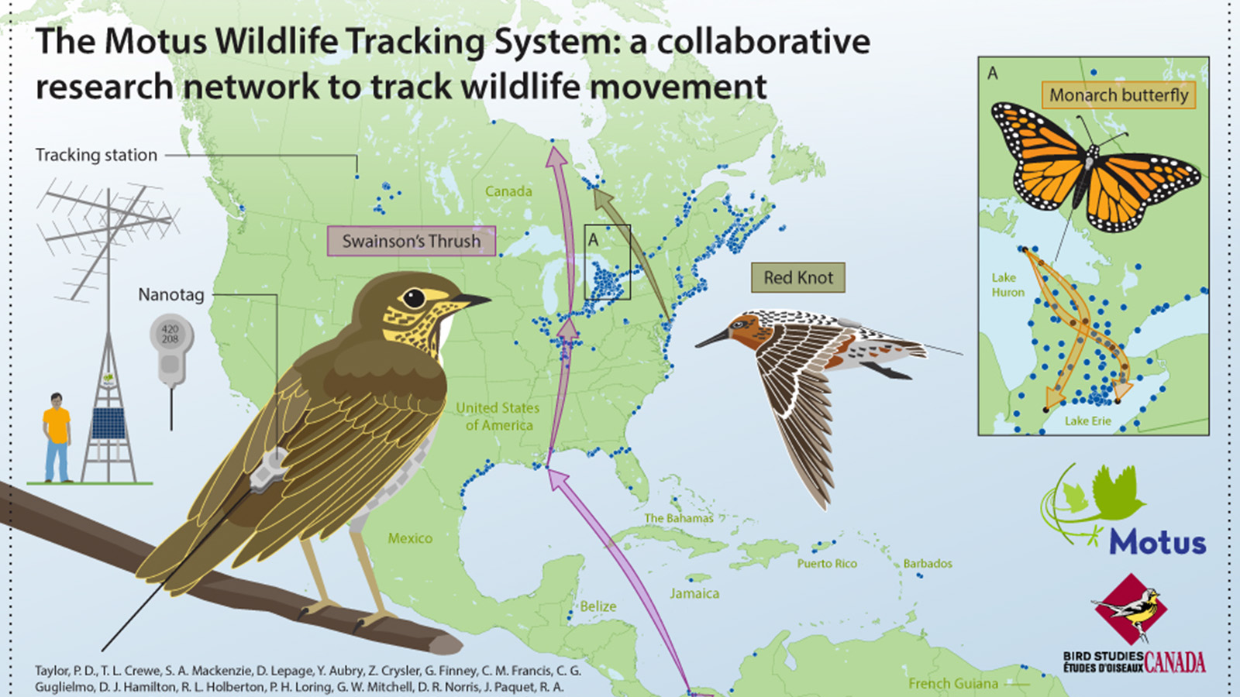
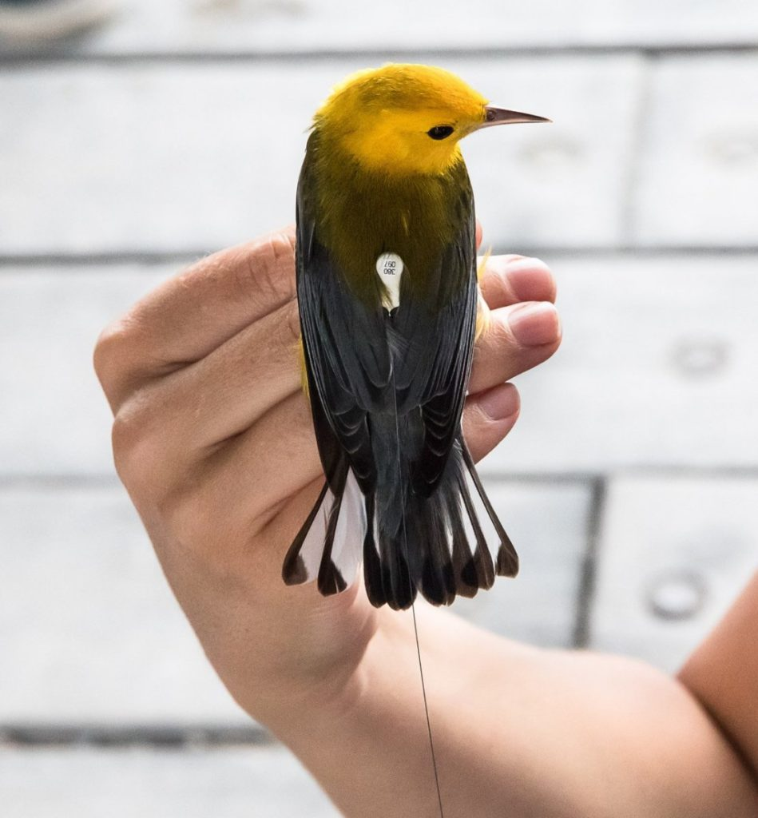
Animal Tracking
Two types of systems
Notes:
A collaborative network of VHF radio towers tracking nanotags on small flying animals.
Design: Semi-Eulerian, as the tags are active, and stations passively log signals from passing animals.
nanotag weights as little as 0.3g

Slide 8
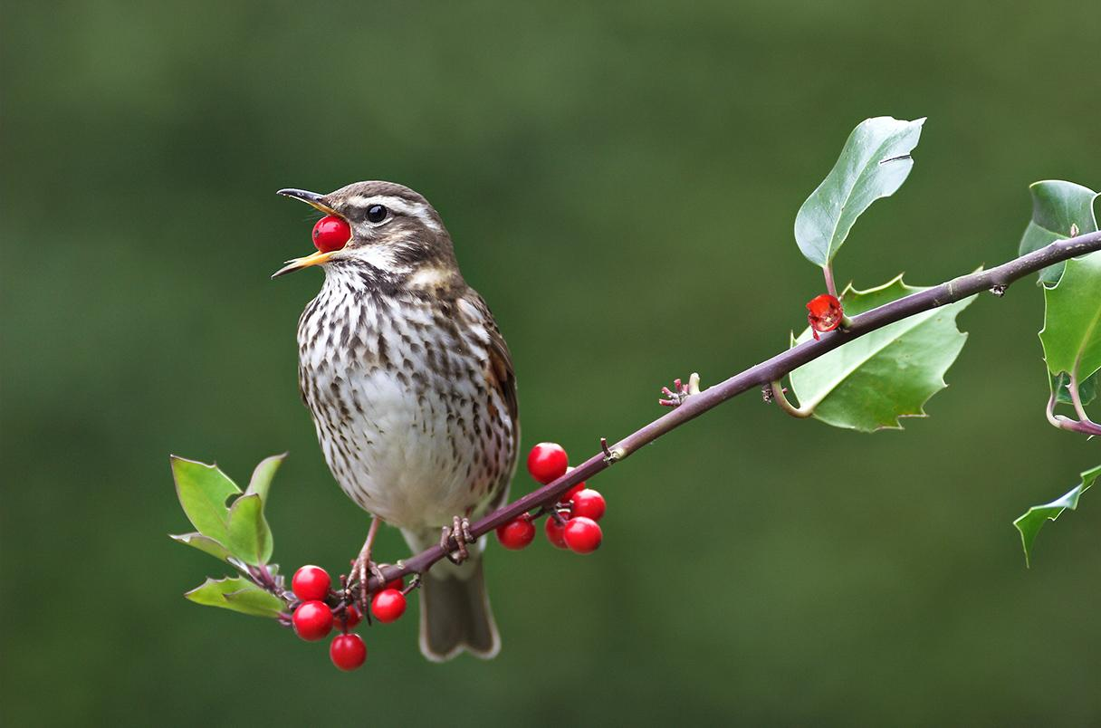
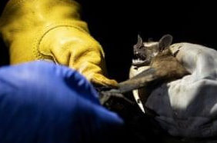
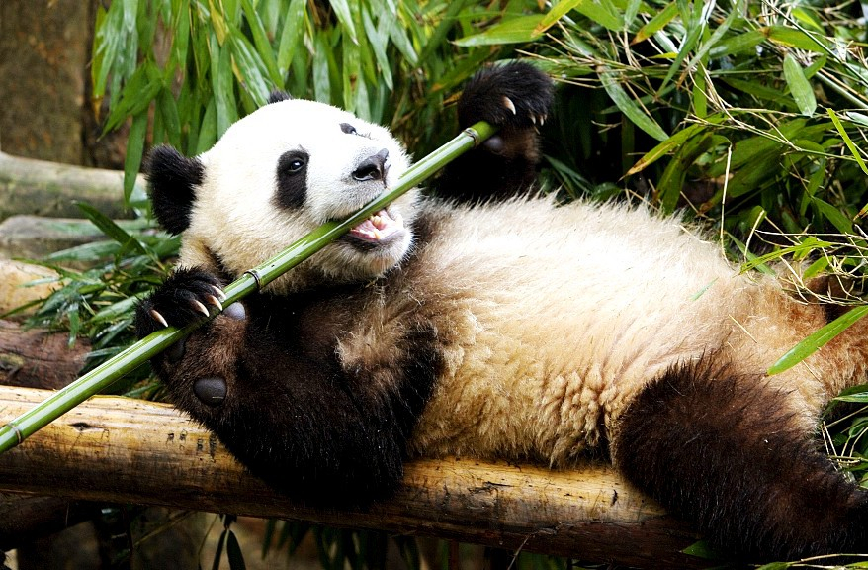
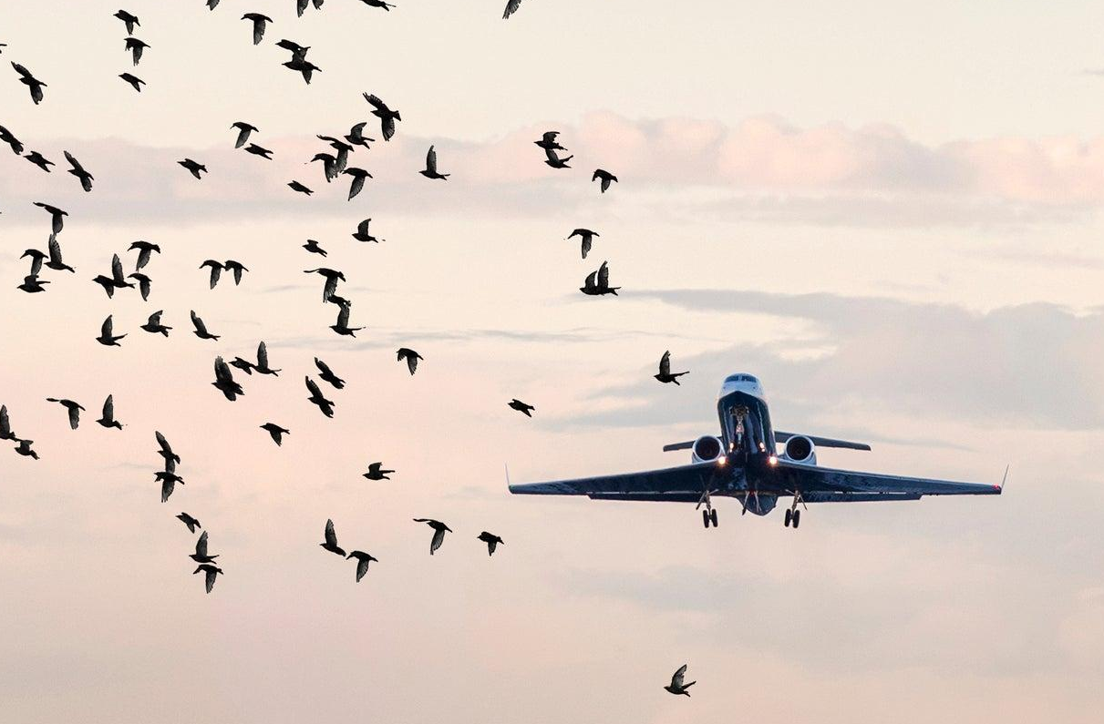
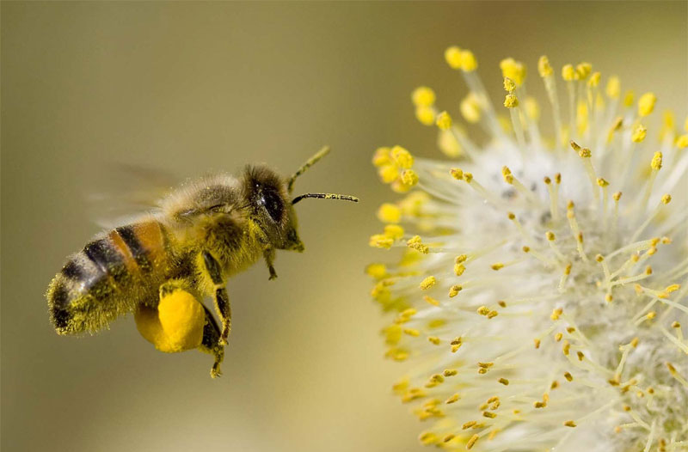
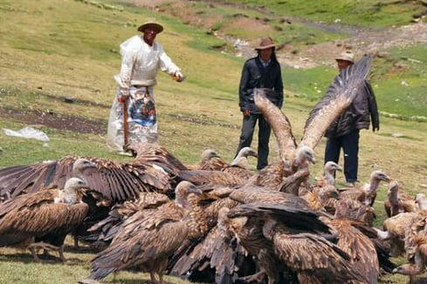
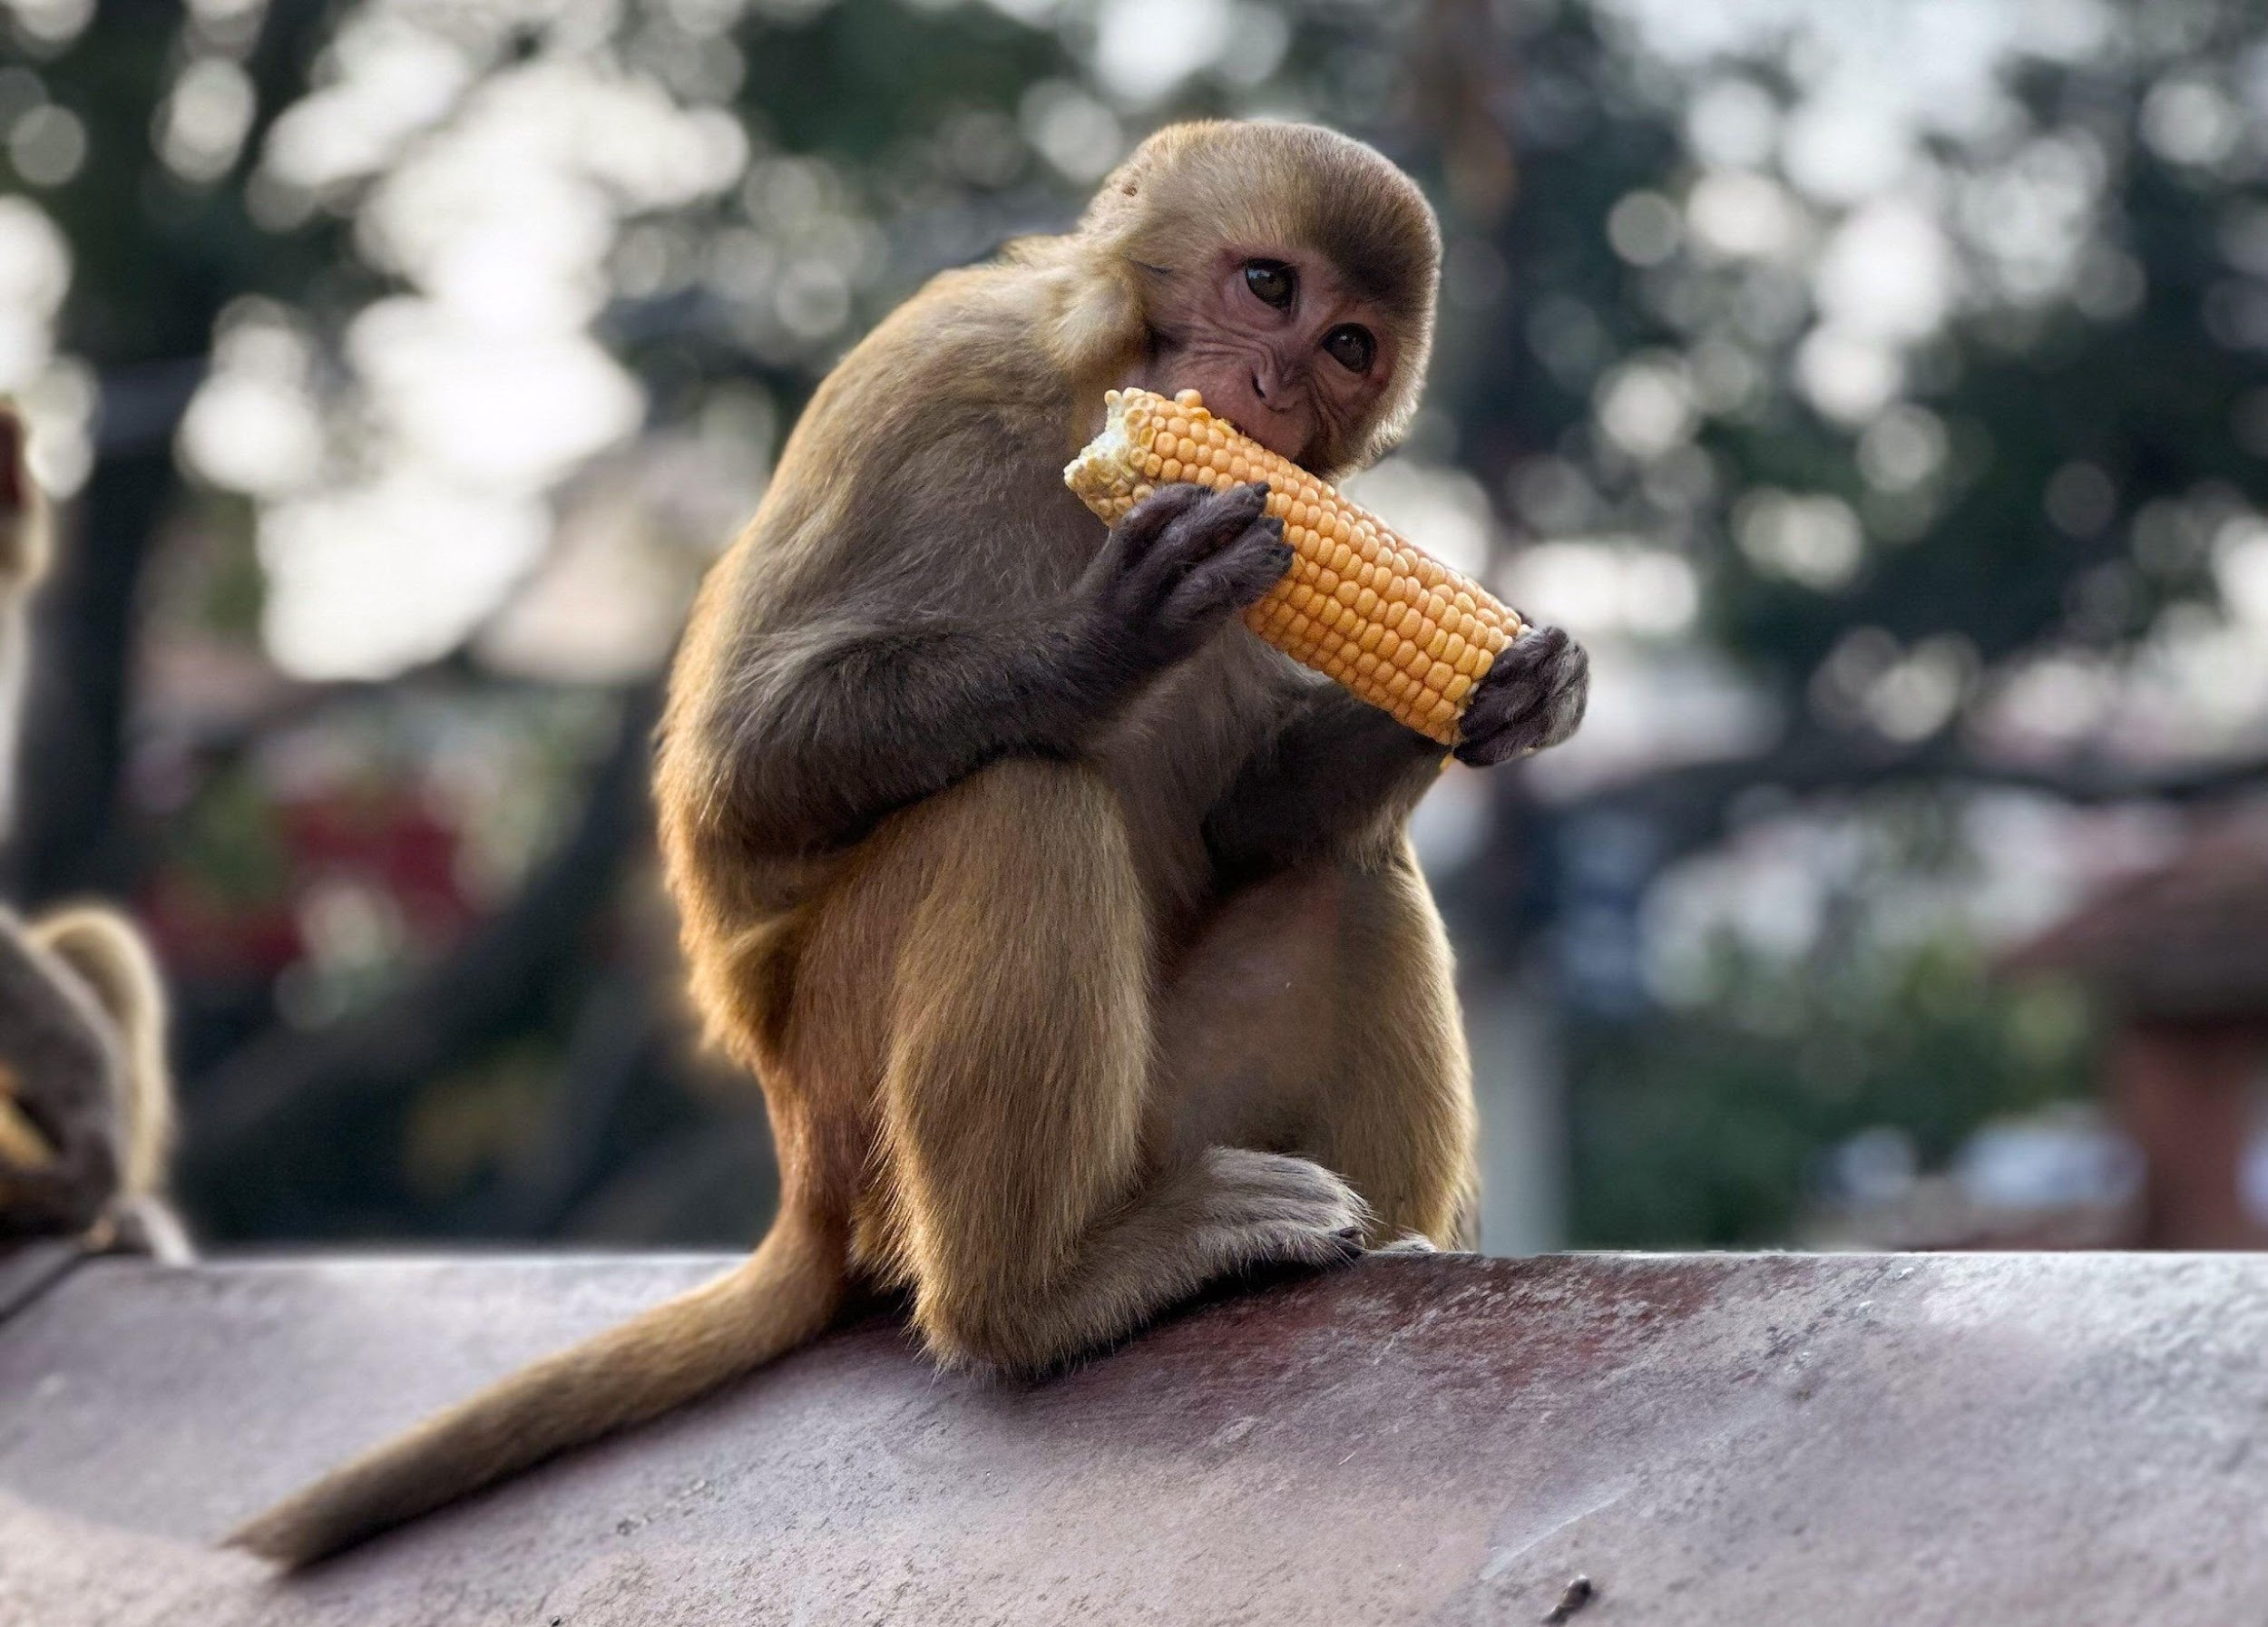
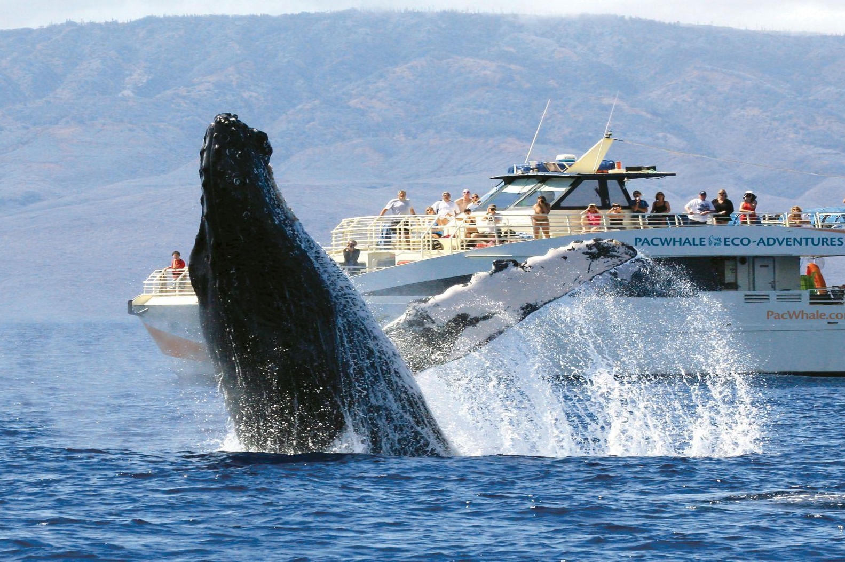
Why care about animal movement?
For natural system
Pest control
Seed dispersal
Pollination
Foraging
Nutrient cycling
…
For human societies
Food sources
Disease transmission
Safety
Tourism
Cultural and spiritual entities
Environmental sentinel
…

Slide 9
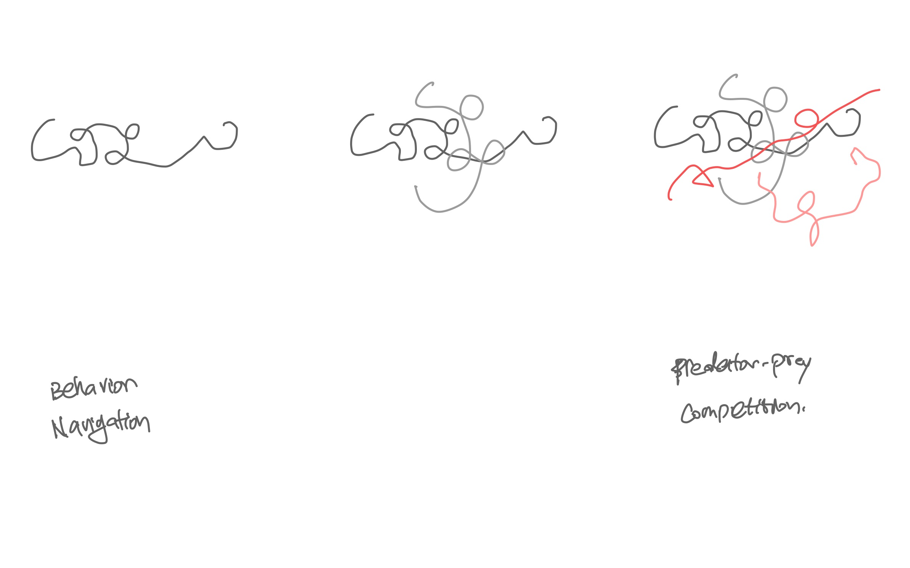
Why care about animal movement?
Animal movements are building blocks of ecology across scales
Individual level
ecophysiology
life history

Slide 10
Why care about animal movement?
Animal movements are building blocks of ecology across scales
Individual level
ecophysiology
life history
Population level
collective behavior
social behavior

Slide 11
Why care about animal movement?
Animal movements are building blocks of ecology across scales
Individual level
ecophysiology
life history
Population level
collective behavior
social behavior
Community level
trophic interaction
disease ecology
Notes:
ecophysiology such as thermal regulation, water relations

Slide 12



Why care about animal movement?
Animal movements are building blocks of ecology across scales
Individual level
Population level
Community level
Interaction with the natural or human-mediated environment
Notes:
habitat connectivity
impact of land use change
human wildlife conflict…

Slide 13
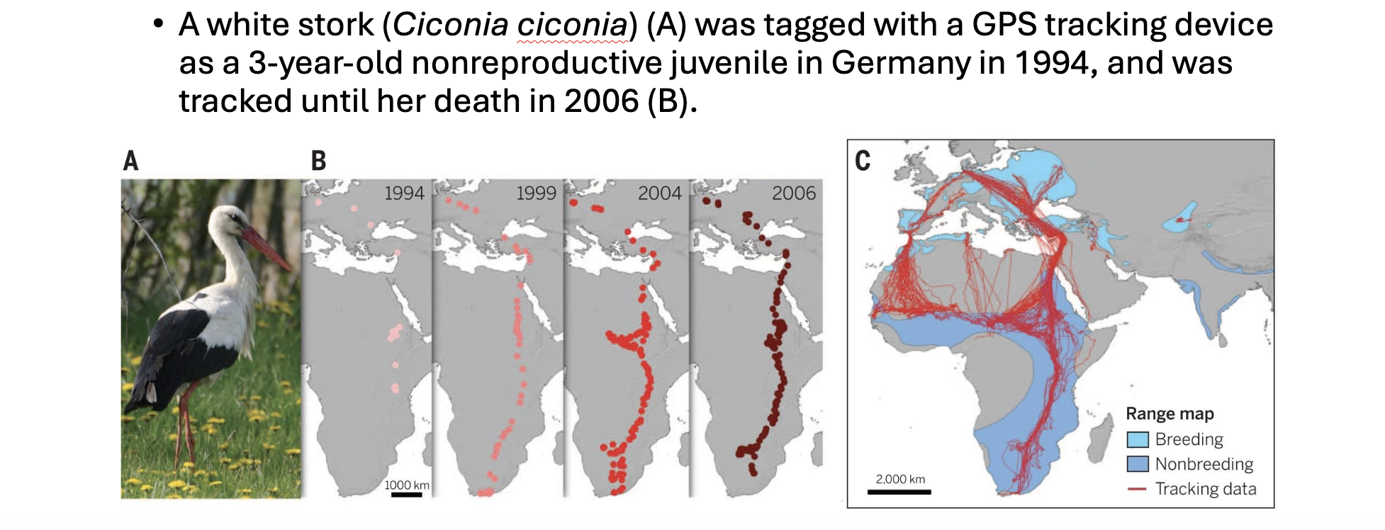
Why care about animal movement?
Animal movements can address global ecological and conservation questions
Kays, et al., 2015 Science

Slide 14
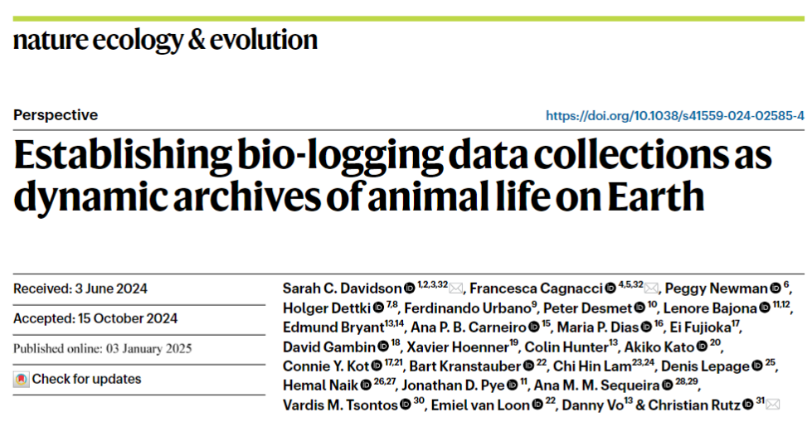
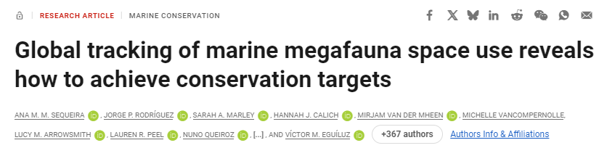
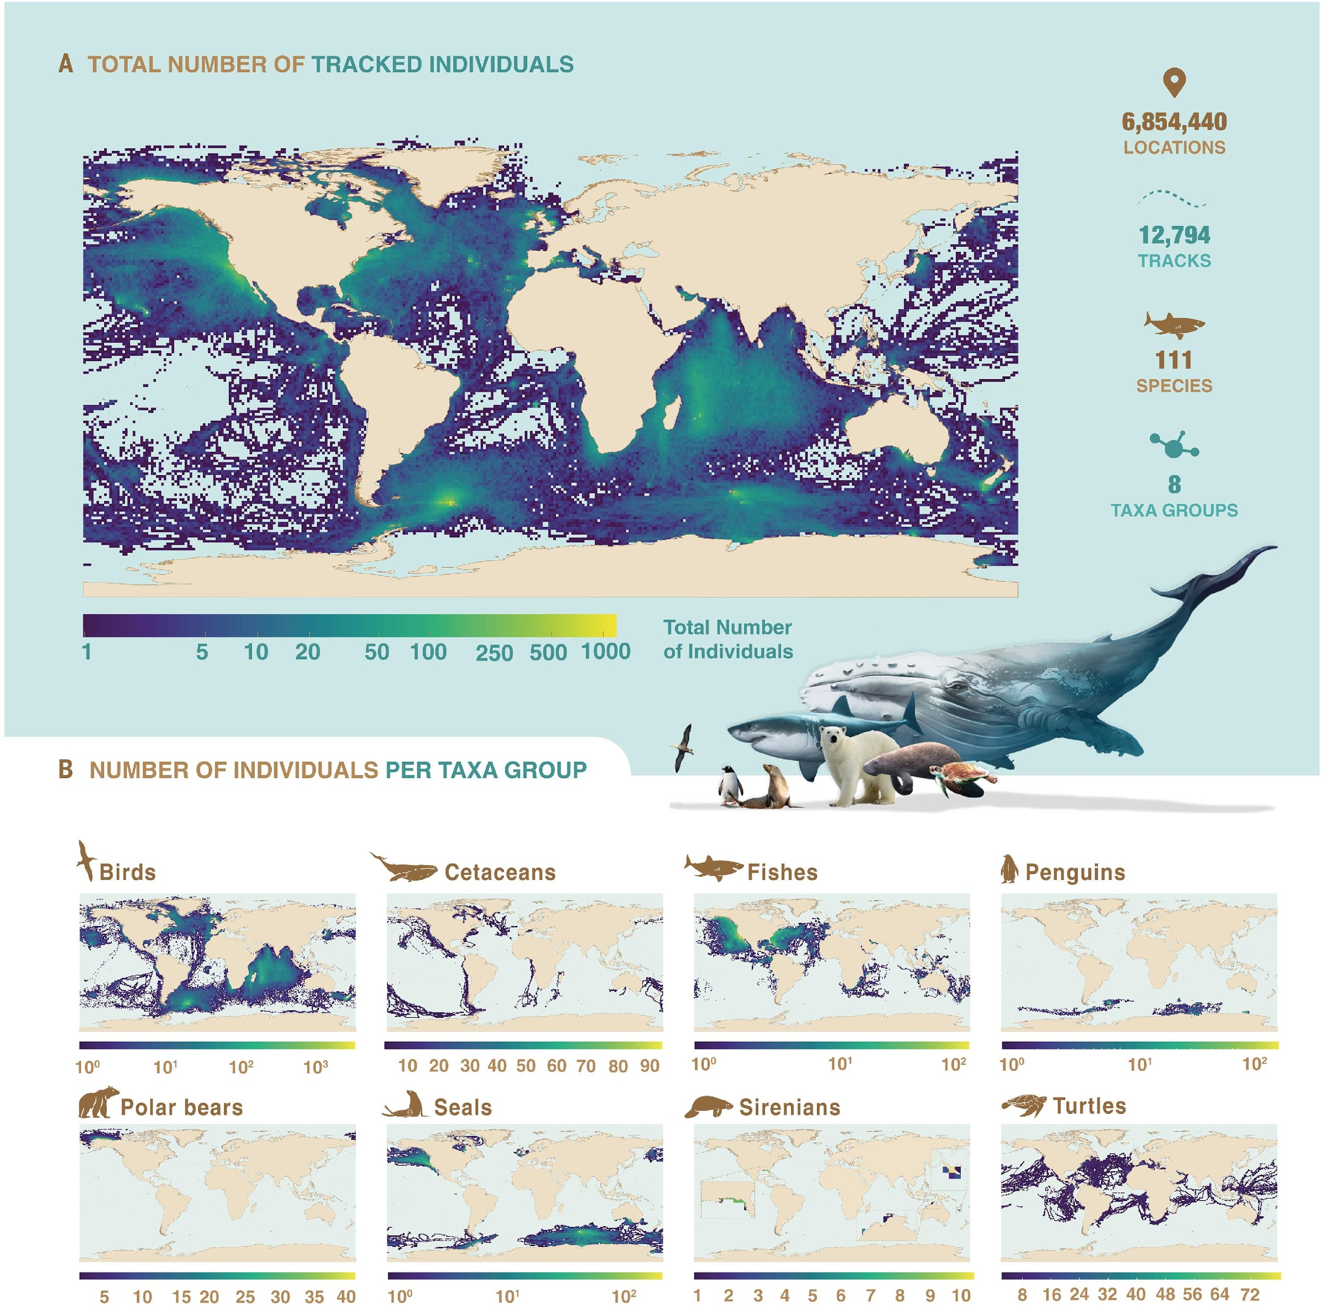
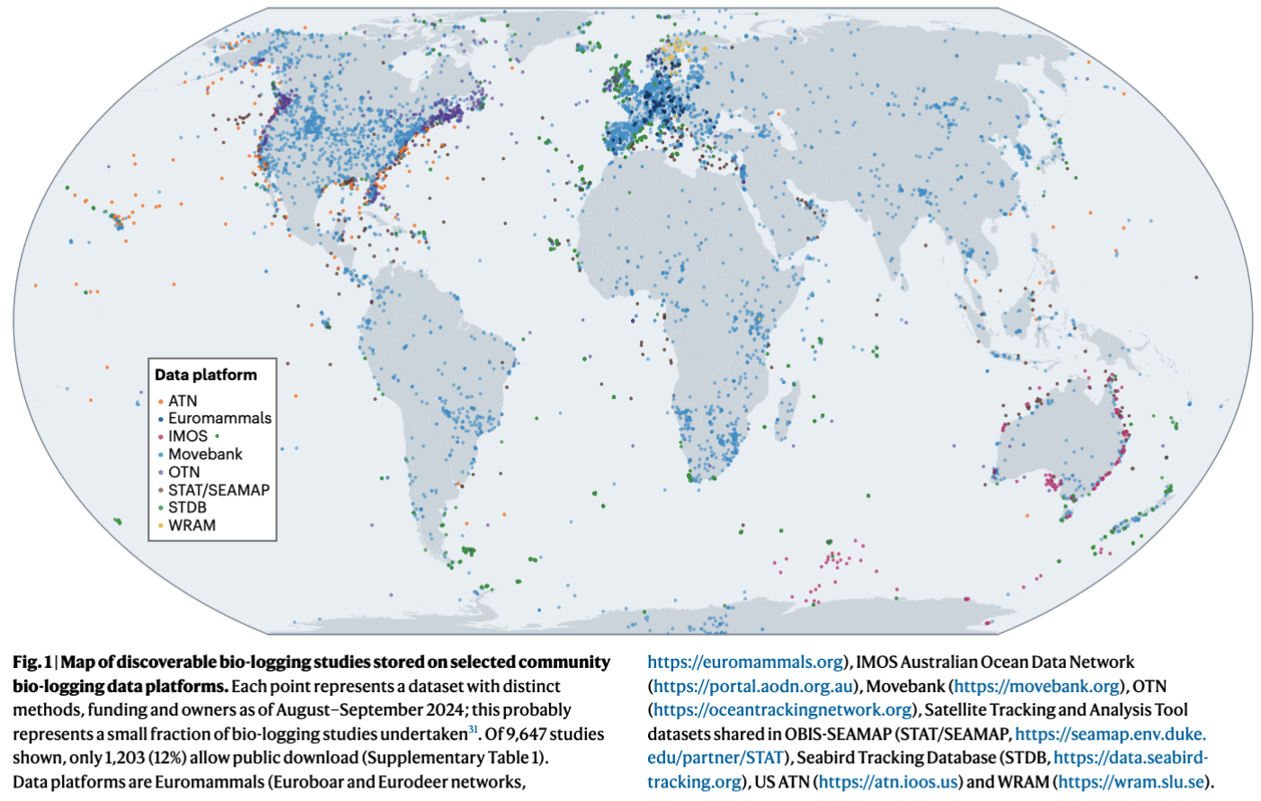
Why care about animal movement?
Animal movements can address global ecological and conservation questions

Slide 15
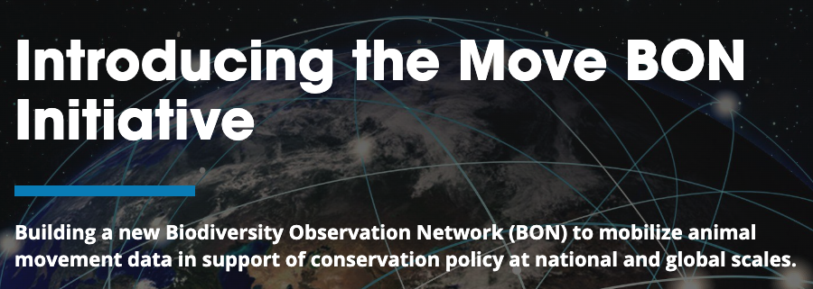
Why care about animal movement?
… and inform global conservation policies
Notes:
Add a bit here

Slide 16
Jul 28 | AM | Introduction to movement ecology
 | PM | Introduction to movement ecology
Jul 29 | AM | Movement metrics (discrete methods) + introduction to continuous time movement model (CTMM)
 | PM | Movement metrics (CTMM-based methods)
Jul 30 | AM | FIELD TRIP!
 | PM | Occurrence & home range
Course Schedule

Slide 17
Jul 31 | AM | Behavioral Inferences (discrete methods)
 | PM | Behavioral Inferences (Continuous-time methods)
Aug 1 | AM | Environmental annotation & Hidden Markov Models
 | PM | CTMM location error
Aug 2 | AM | Resource & step selection
 | PM | Practice time
Course Schedule

Slide 18
Q & A
Mini-lectures + exercise
Practice with your own dataset with your group
Course Structure

Slide 19
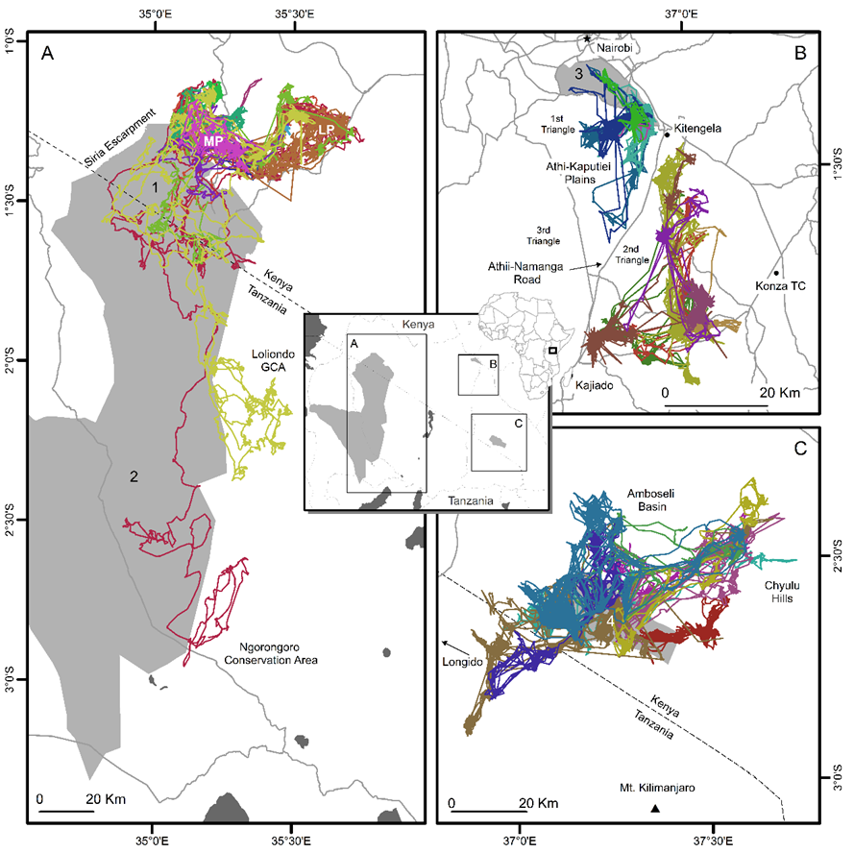
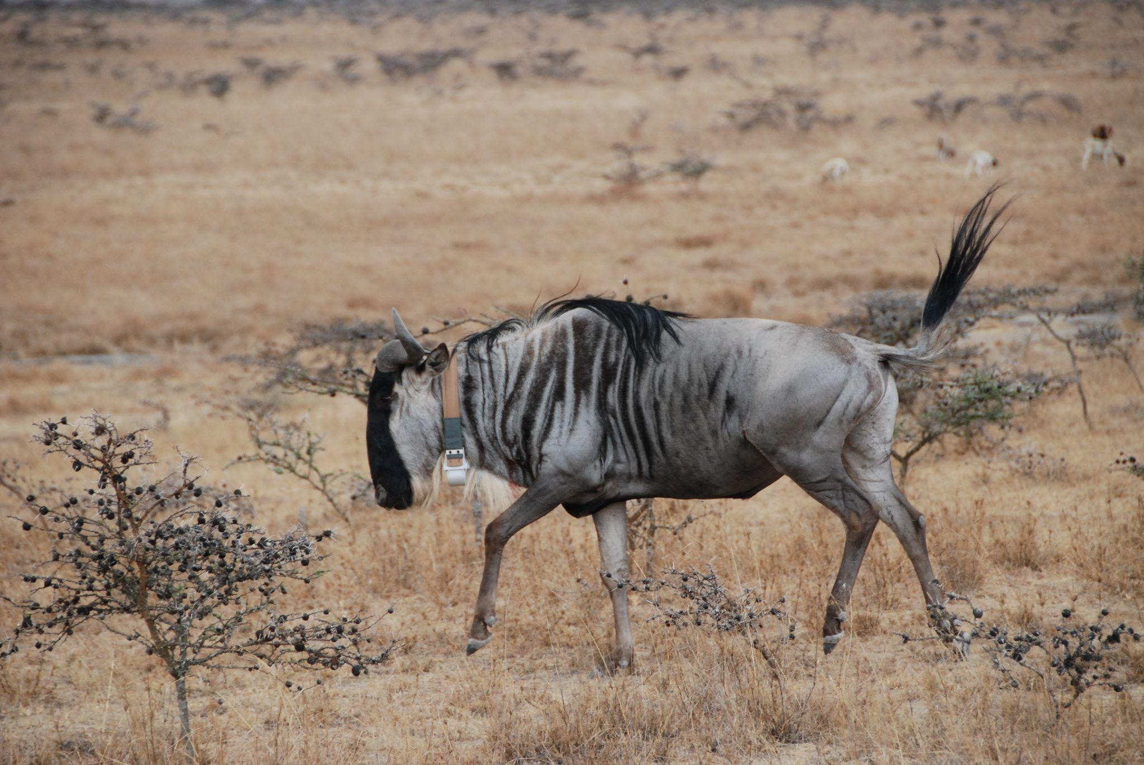
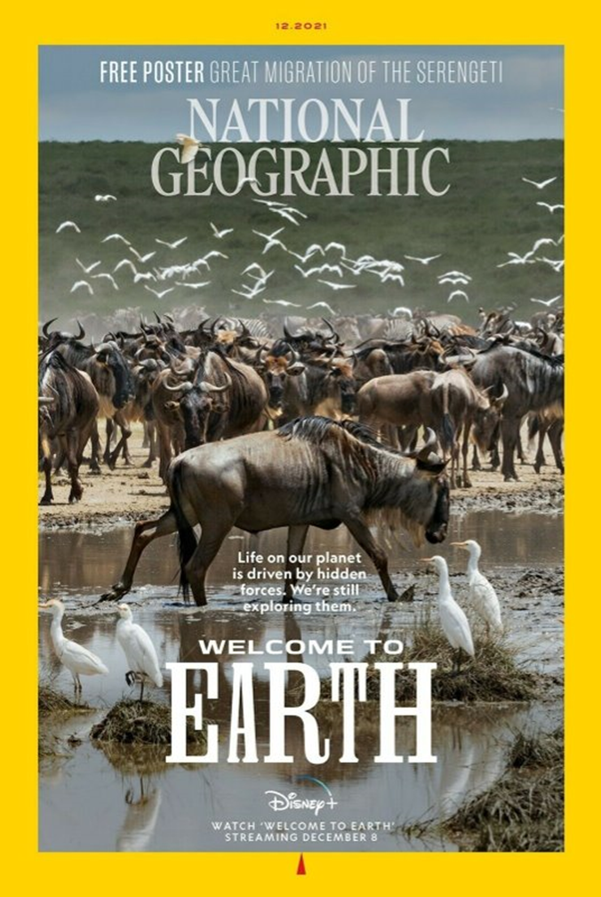
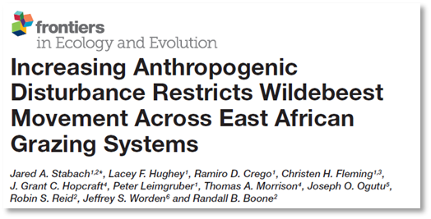
Core Dataset
White-bearded Wildebeest (Connochaetes taurinus)
Total individuals monitored: 36
Total populations: 3
Amboseli Basin (n = 9)
Athi-Kaputiei Plains (n = 12)
Mara-Loita Plains (n = 15)
Collection date: 2010-2013
Total number of points: 276,706
Data publicly available on Movebank

Slide 20
Questions?

Slide 21
How to track animals Eulerian sampling
X–Y at predetermined frame of reference
Often replicated through time
Movement needs to be reconstructed
Individual sampling intervals cannot be guaranteed
Great for enclosed system
Transmitter
Fixed location receiver
Notes:
Camera traps is another type of eulerian anmal tracking

Slide 22
How to track animals Lagrangian sampling
Animal-borne tracking devices
Pre-determined data collection intervals
Raw data already contains continuous X-Y-T information

Slide 23
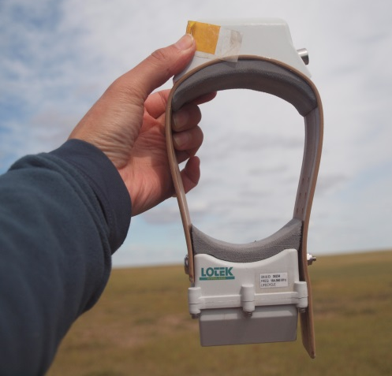
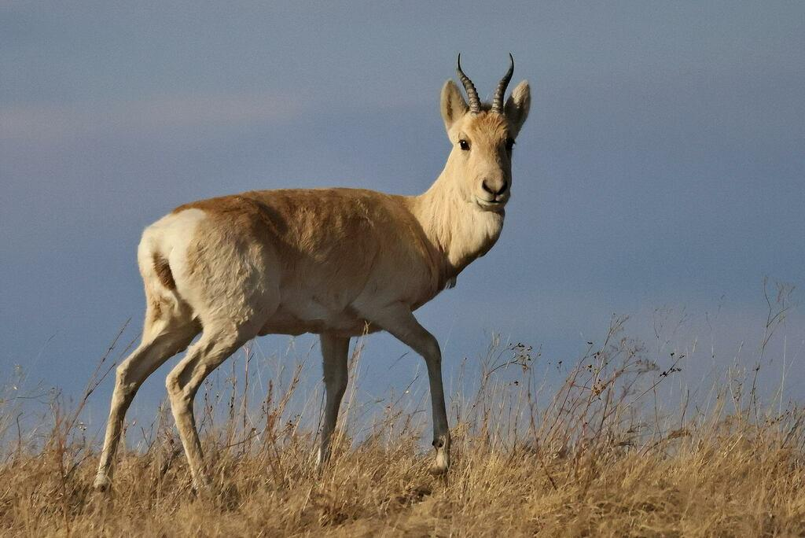
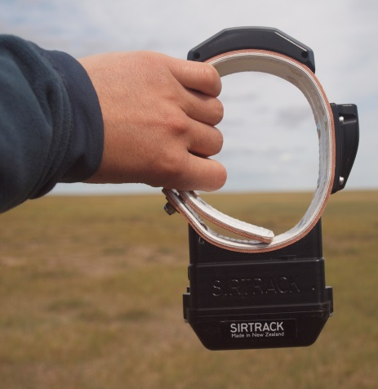
How to track animals
Choose tracking device & think about how to attach to the animal safely
species biology and ecology, body size and weight, sex, age, shape, research goals…
20-39 kg
© Nandingstesteg Dejid
Notes:
Earlier you have heard

Slide 24
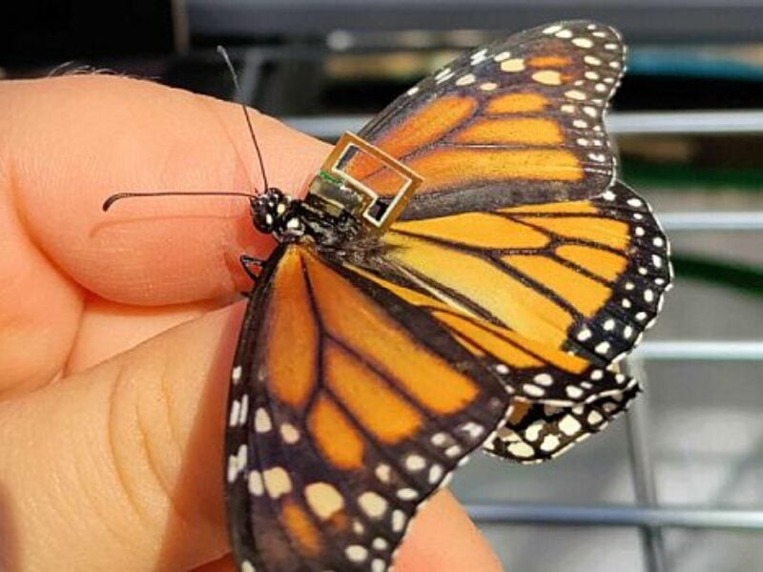
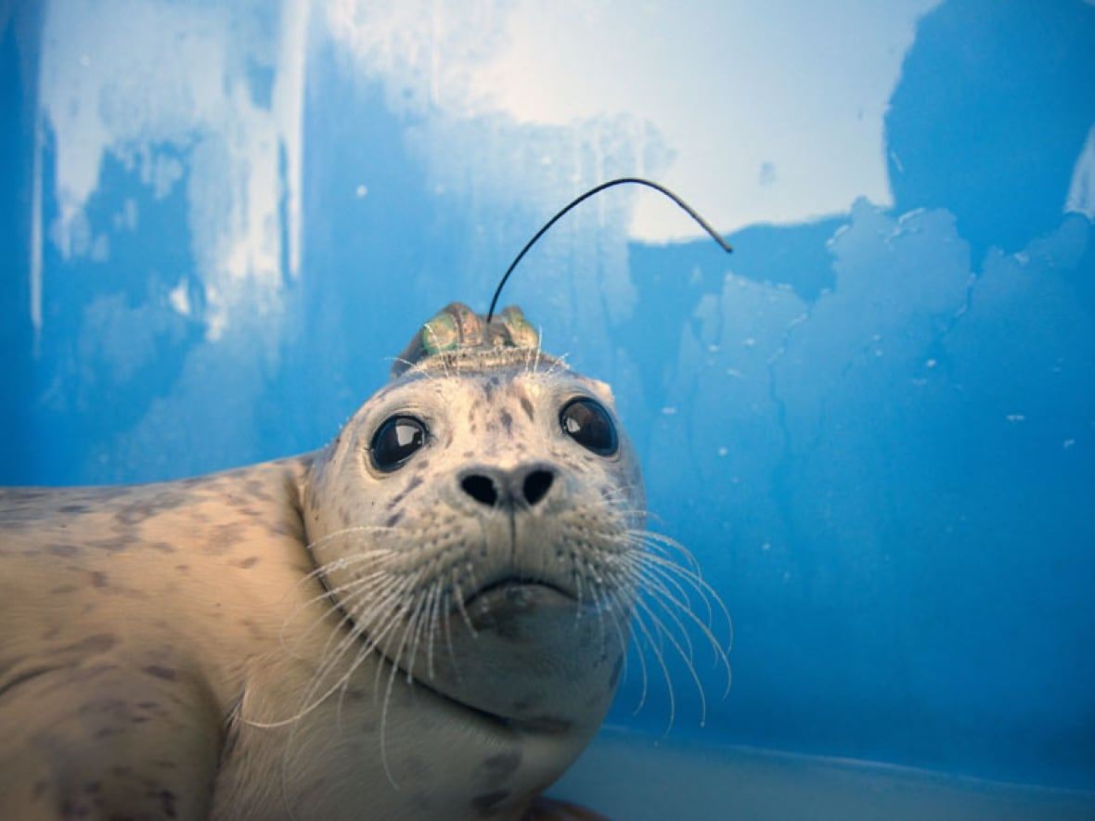
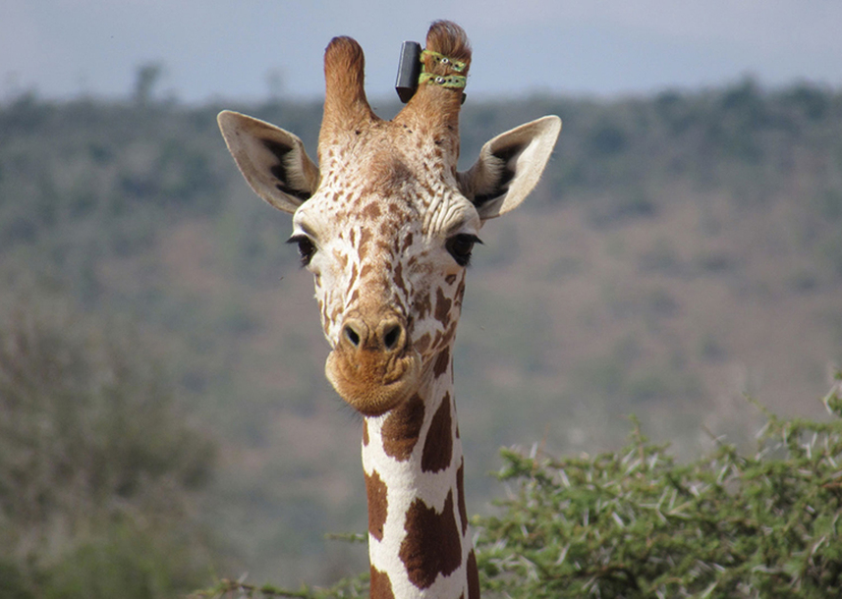
How to track animals
Choose tracking device & think about how to attach to the animal safely
species biology and ecology, body size and weight, sex, age, shape, research goals…
Notes:
They bare the burden
Cannot overlook the potential negative impacts we have on animals

Slide 25
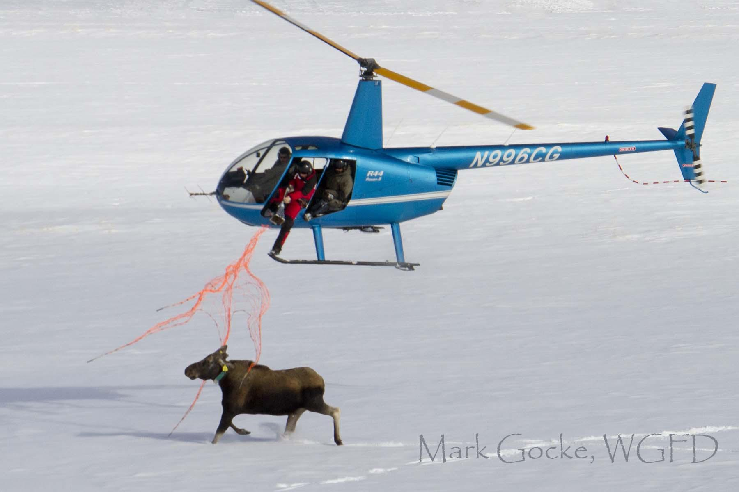
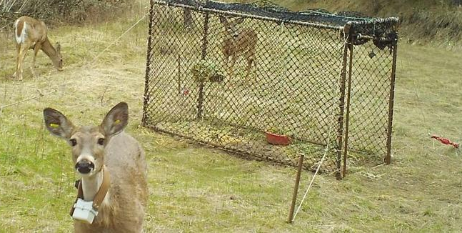
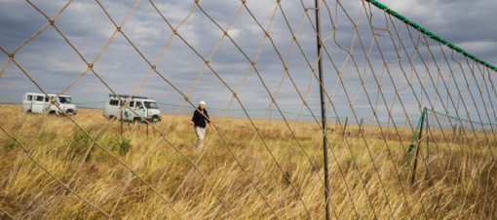
How to track animals
2. Choose a capture and handling methods
Species ecology, body size, timing, landscape, funding, local community relationships
Notes:
Many different capture methods, each has pros and cons. Different groups should come together to work out

